Slide 1
BEACH ROAD IMPROVEMENT PROJECT
VIA SPECIAL BENEFIT TAX ASSESSMENT
2nd PUBLIC INFORMATION MEETING
OCTOBER 6TH 6:00 PM
CHIEF ROADS ENGINEER: R. SHANE MOORE, P.E.
KENT ISLAND ESTATES ROADS ASSOCIATION: VERONICA BECK
DIRECTOR OF PUBLIC WORKS: ALAN QUIMBY, P.E.
COUNTY ADMINSTRATOR : TODD R. MOHN, P.E.
COUNTY ATTORNEY: PATRICK THOMPSON
DIRECTOR OF FINANCE: JEFFREY A. RANK
PROJECT MANAGER: PAUL SIDUN, CIVIL ENGINEER III
CONSULTANTS: D.M.S. AND ASSOCIATES
COUNTY COMMISSIONERS/ROADS BOARD: JAMES J. MORAN
JACK N. WILSON
J. PATRICK MCLAUGHLIN
PHILIP L. DUMENIL
CHRISTOPHER M. CORCHIARINO

Slide 2
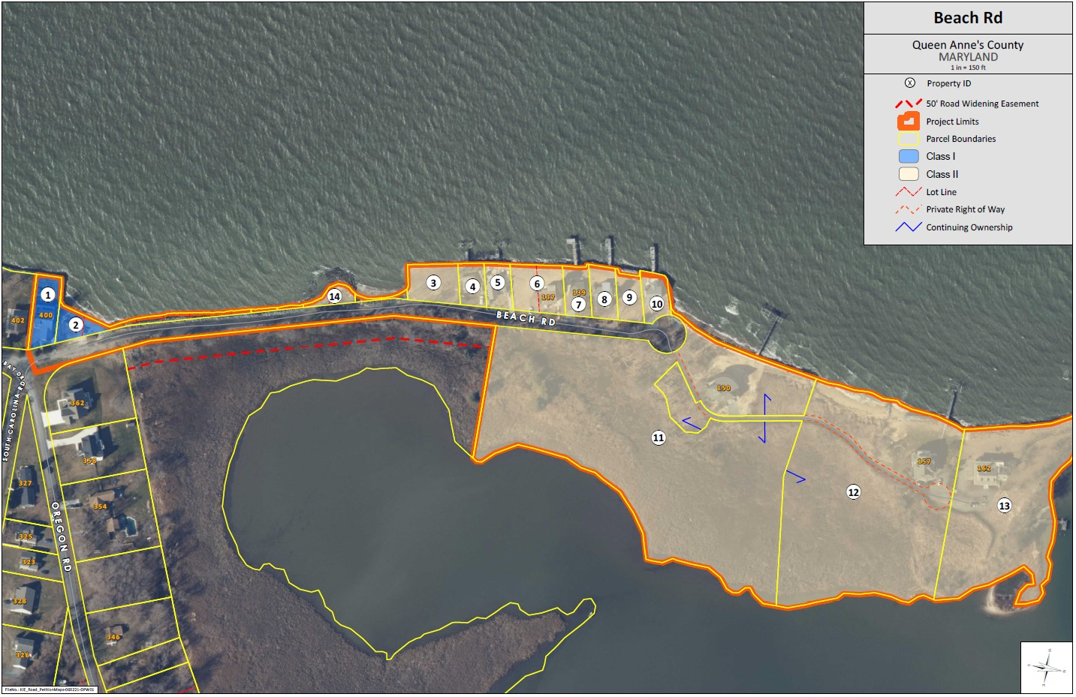
BEACH ROAD ASSESSMENT AREA

Slide 3
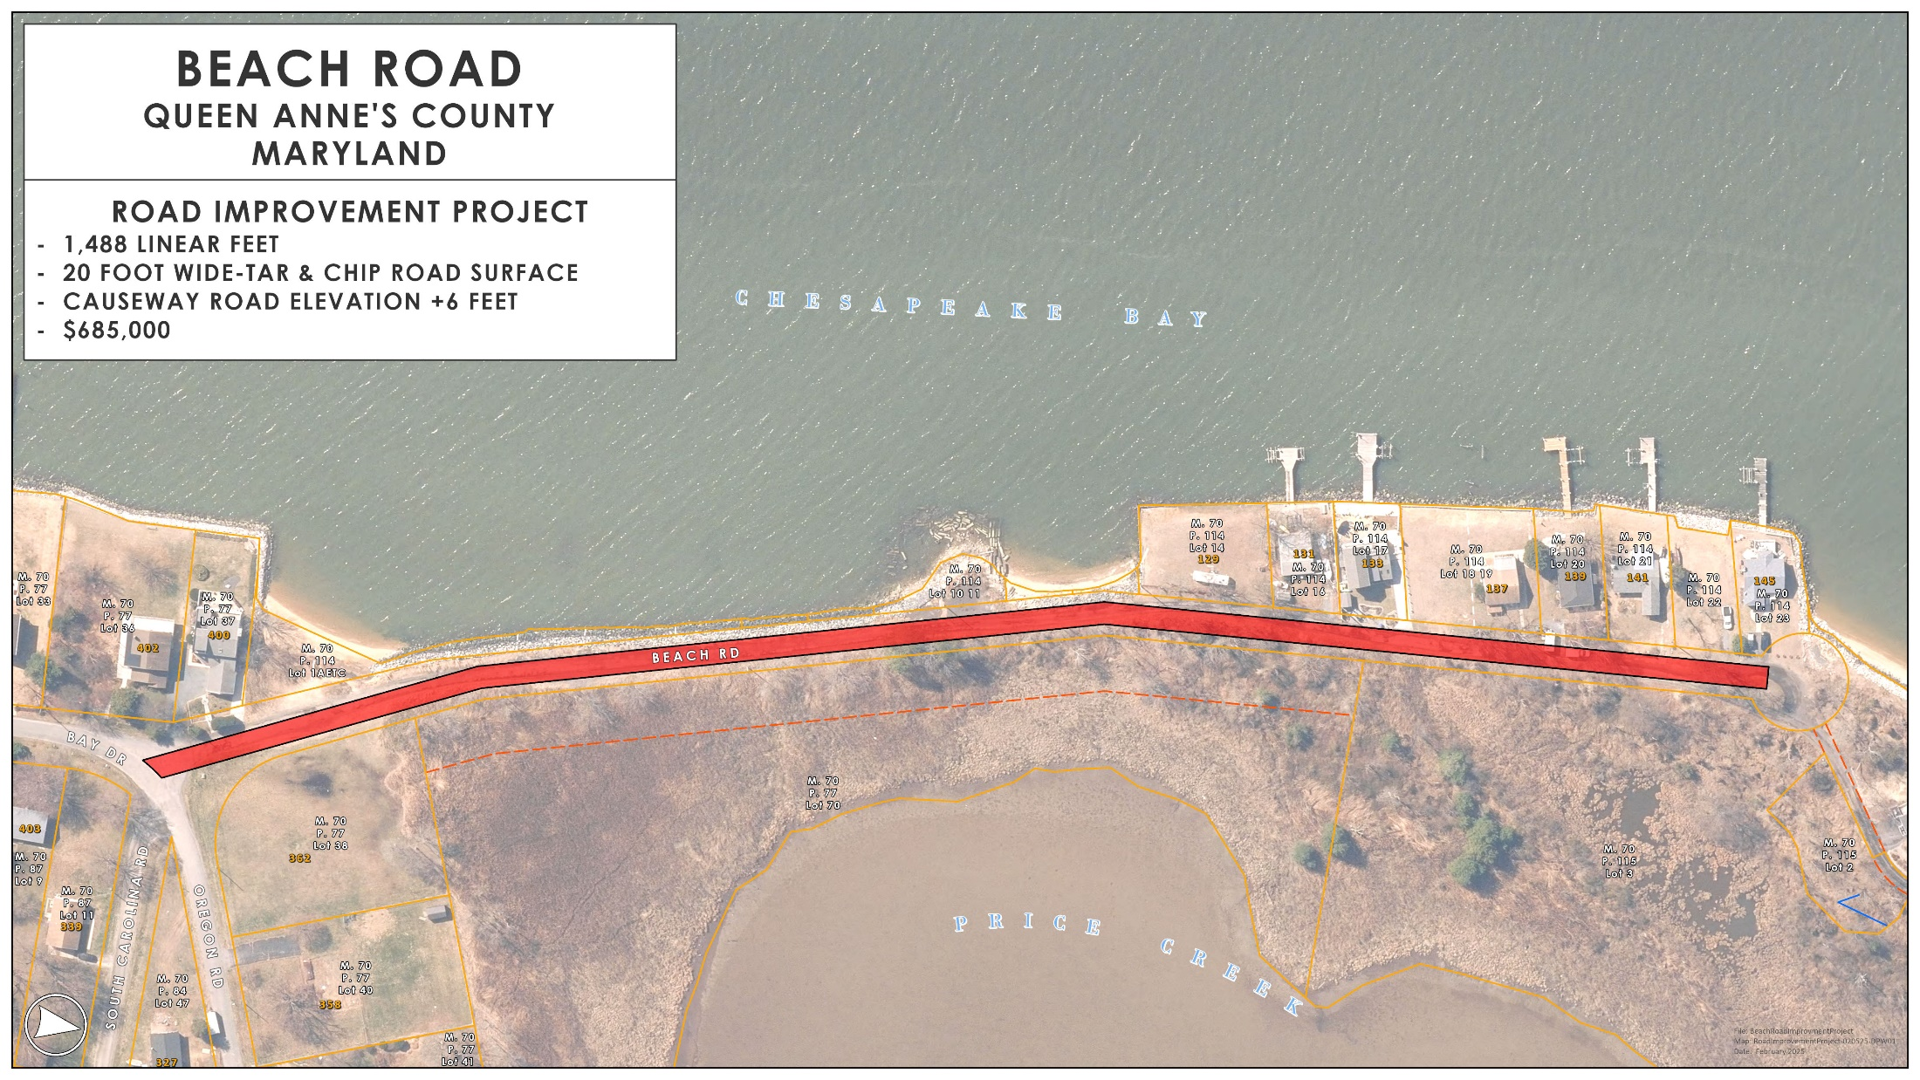

Slide 4
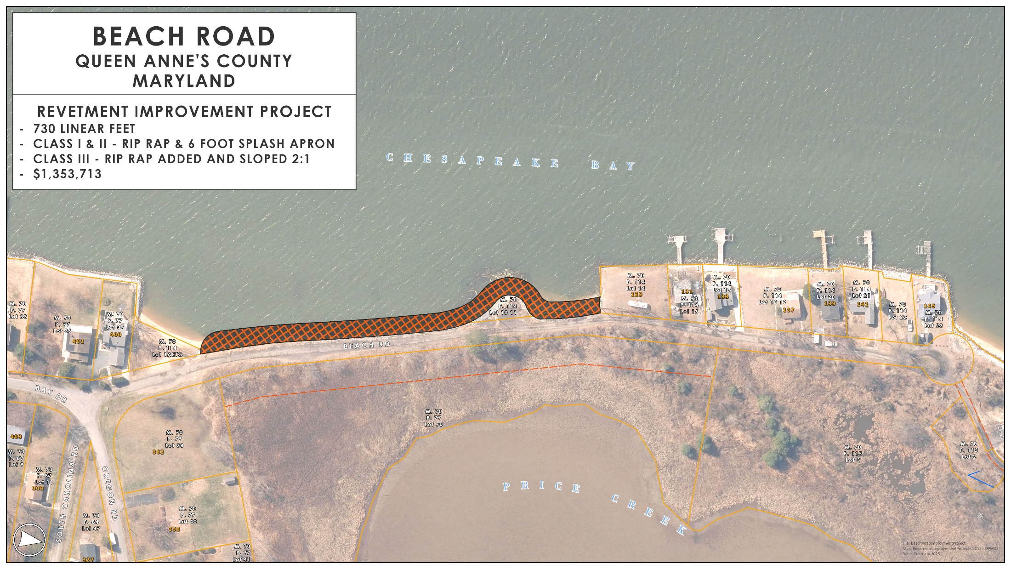

Slide 5
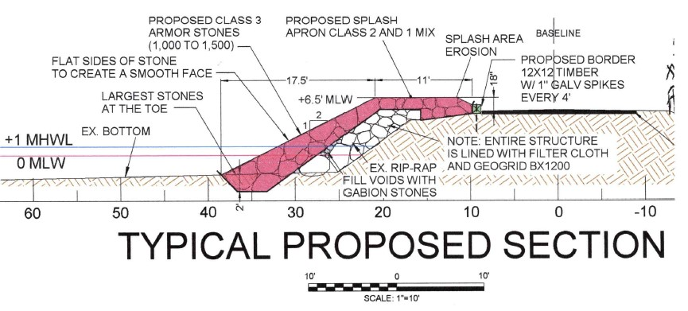
BEACH ROAD REVETMENT
CROSS SECTION
BY DOLDON MOORE AND ASSOCIATES

Slide 6
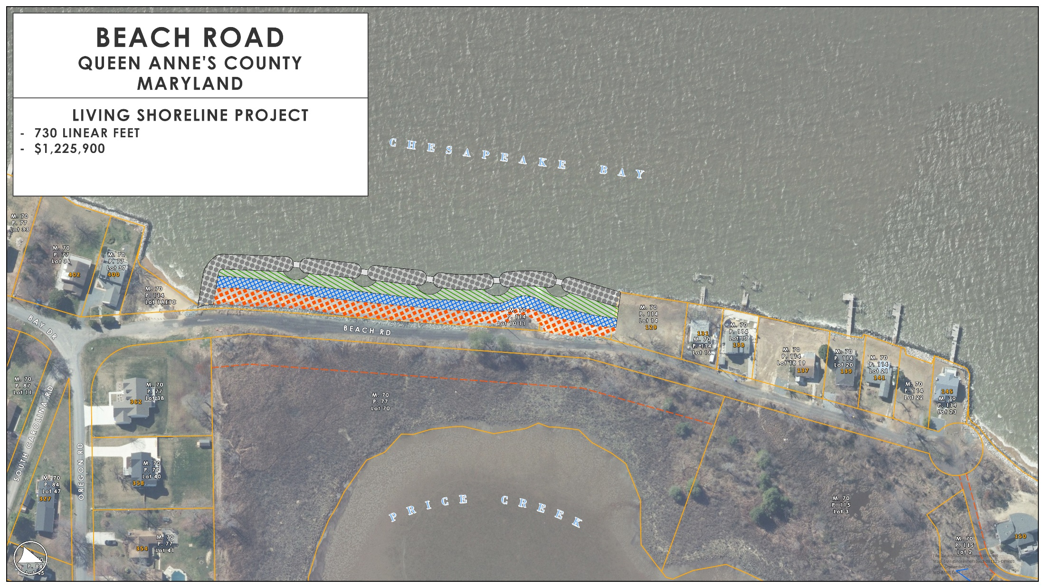

Slide 7
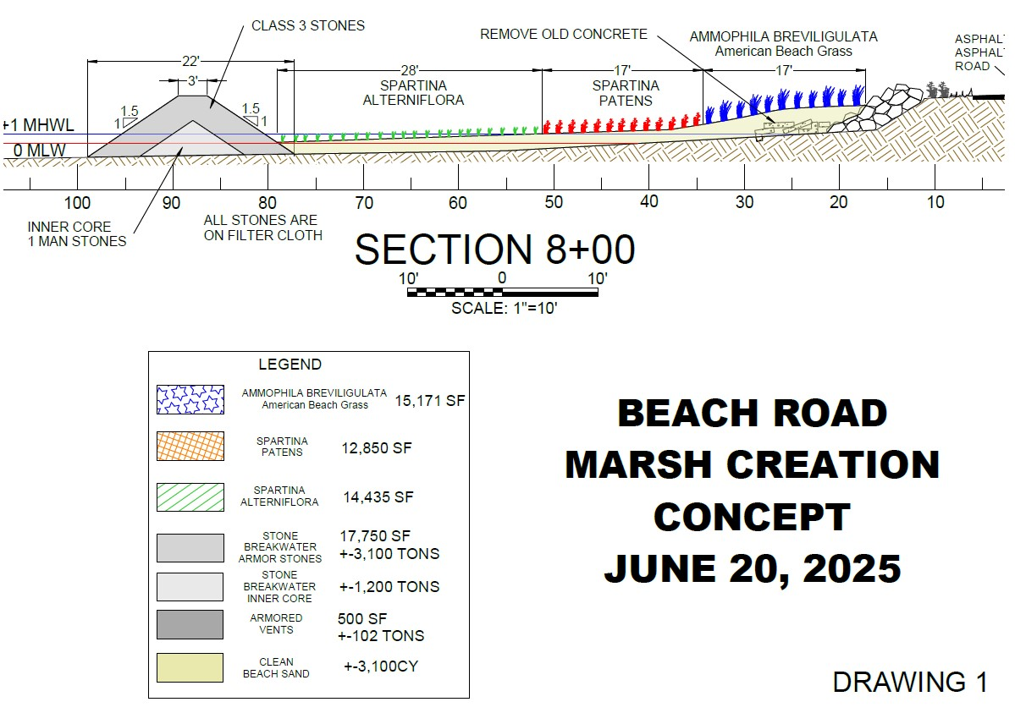
BEACH ROAD LIVING SHORELINE
CROSS SECTION
BY DOLDON MOORE AND ASSOCIATES

Slide 8
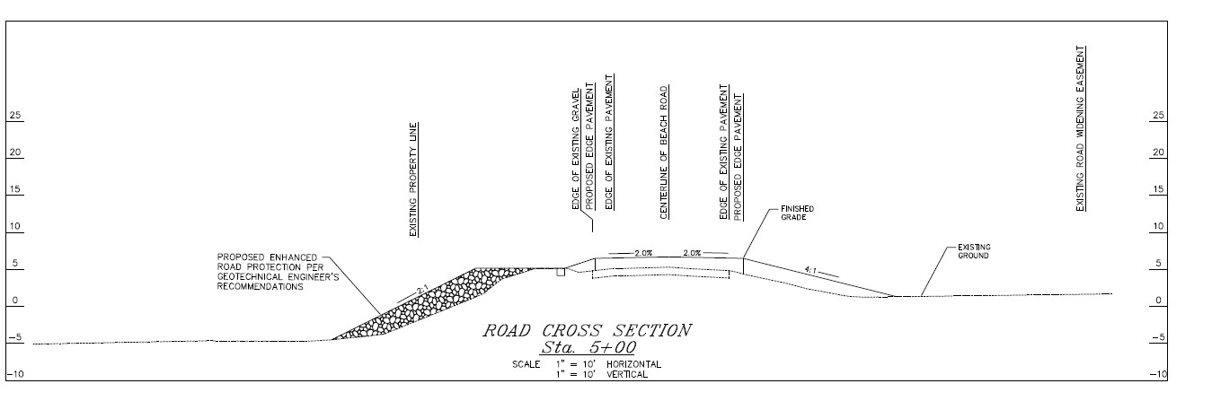
BEACH ROAD CAUSEWAY
CROSS SECTION
BY D.M.S. AND ASSOCIATES

Slide 9
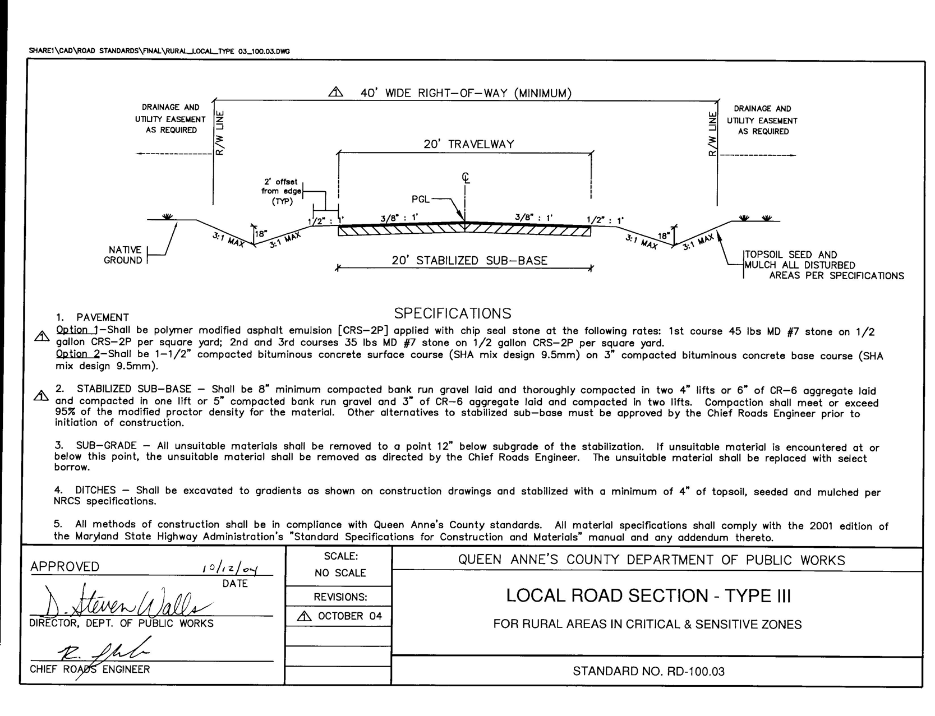

Slide 10
BEACH ROAD – ROAD IMPROVEMENTS
TOTAL LENGTH 1,488’
CURRENT WIDTH 14’
PROPOSED WIDTH 20’
RIGHT-OF-WAY 40’
CONSTRUCTION SEQUENCE:
CLEAR AND GRUBBING WITHIN THE RIGHT-OF-WAY AND DRAINAGE EASEMENTS
CLEAN AND GRADE THE PRIMARY STORMWATER OUTFALL DITCHES
STORMWATER MANAGEMENT
RE-GRADE THE OPEN SECTION ROADSIDE DITCHES AND INSTALLATION OF ENTRANCE CULVERTS
ROADWAY BASE WIDENING
ROADWAY RECLAMATION, ADD MATERIAL (+6FT), GRADE AND COMPACTION
RESURFACE WITH THREE COURSES OF TAR AND CHIP
DRIVEWAY TIE-INS, HYDROSEEDING AND FINAL RESTORATION

Slide 11
BEACH ROAD– ROAD IMPROVEMENTS ESTIMATED COSTS AND PAYMENT
TOTAL ESTIMATED PROJECT COST: $685,000
ASSESSMENT TERM: 20 YEARS
FINAL INTEREST RATE: 4%
TOTAL PROPERTY OWNERS: 14
ESTIMATED COST PER OWNER: $48,929
ASSESSMENT PAYMENT OPTIONS FOR 20 YEARS:
SINGLE PAYMENT $48,929
ANNUAL PAYMENT $3,600

Slide 12
BEACH ROAD REVETMENT IMPROVEMENTS
TOTAL LENGTH 730’
RIP-RAP CLASS I-II
SLOPE > 2:1
CONSTRUCTION SEQUENCE:
ADD GETOEXTILE MEMBRANE
REUSE AND RESHAPE EXISITNG CLASS I-II RIP-RAP
CREATE TOE FOR NEW CLASS III RIP-RAP
ADD AND SHAPE NEW CLASS III RIP-RAP
NEW SLOPE 2:1
NEW RIP-RAP ELEVATION OF 6 FT
CONSTRUCT RIP-RAP SPLASH PROTECTION
FINAL RESTORATION

Slide 13
BEACH ROAD– REVETMENT
ESTIMATED COSTS AND PAYMENT
TOTAL ESTIMATED PROJECT COST: $664,000
ASSESSMENT TERM: 20 YEARS
FINAL INTEREST RATE: 4%
TOTAL PROPERTY OWNERS: 12
ESTIMATED COST PER OWNER: $55,333
ASSESSMENT PAYMENT OPTIONS FOR 20 YEARS:
SINGLE PAYMENT $55,333
ANNUAL PAYMENT $4,072

Slide 14
BEACH ROAD LIVING SHORELINE IMPROVEMENTS
TOTAL LENGTH 730’
RIP-RAP CLASS I-II
SLOPE >2:1
CONSTRUCTION SEQUENCE:
ADD GETOEXTILE MEMBRANE
CREATE TOE FOR NEW CLASS III RIP-RAP BREAKWATERS
CONSTRUCT BREAKWATERS WITH CLASS III RIP-RAP, 5:1 SLOPE, 3’ TOP
BACKFILL WITH CLEAN BEACH SAND
PLANT SPARTINA ALTERNIFLORA
PLANT SPARTINA PATENS
PLANT AMMOPHILA BREVILIGULATA
FINAL RESTORATION

Slide 15
BEACH ROAD – LIVING SHORELINE
ESTIMATED COSTS AND PAYMENT
TOTAL ESTIMATED PROJECT COST: $1,225,990
ASSESSMENT TERM: 20 YEARS
FINAL INTEREST RATE: 0%
TOTAL PROPERTY OWNERS: 12
ESTIMATED COST PER OWNER: $102,158
ASSESSMENT PAYMENT OPTIONS FOR 20 YEARS:
SINGLE PAYMENT $102,158
ANNUAL PAYMENT $5,108

Slide 16
BEACH ROAD – SPECIAL BENEFIT TAX ASSESSMENT BREAKDOWN
PROPERTY OWNERS 1 AND 2 (ROAD ASSESSMENT ONLY)
1/14TH OF $685,000
SINGLE PAYMENT $48,929
ANNUAL PAYMENT FOR 20 YEARS $3,600
PROPERTY OWNERS 3 THROUGH 14 (ROAD/REVETMENT ASSESSMENT)
1/14TH OF $685,000 + 1/12TH OF $664,000
SINGLE PAYMENT $104,262
ANNUAL PAYMENT FOR 20 YEARS $7,672
PROPERTY OWNERS 3 THROUGH 14 (ROAD/LIVING SHORELINE ASSESSMENT)
1/14TH OF $685,000 + 1/12TH OF $1,225,900
SINGLE PAYMENT $151,087
ANNUAL PAYMENT FOR 20 YEARS $8,708

Slide 17
BEACH ROAD – OPTIONS MOVING FORWARD
OPTION 2a – ROAD/REVETMENT PROJECT
DIRECT DOLDON MOORE AND ASSOCIATES TO APPLY FOR LIVING SHORELINE WAIVER
FINALIZE AND APPLY FOR JOINT PERMIT APPLICATION FOR STONE REVETMENT
UPON APPROVAL HOLD PUBLIC HEARING FOR THE COUNTY COMMISSIONERS TO MAKE A FINAL DETERMINATION
PROS – APPROXIMATE 1 YEAR PERMITTING TIMELINE, COSTS MOSTLY KNOWN, MAINTENANCE
CONS – NOT THE PREFERRED ENVIRONMENTAL SOLUTION, NO GRANT OR FUNDING ASSISTANCE OPPORTUNITIES
OPTION 2b – ROAD/LIVING SHORELINE, DNR ZERO INTEREST LOAN PROGRAM
APPLY FOR AND WORK TO OBTAIN JOINT PERMIT APPLICATION FOR A LIVING SHORELINE
SUBMIT PROJECT TO DNR ZERO INTEREST LOAN PROGRAM
UPON APPROVAL HOLD PUBLIC HEARING FOR THE COUNTY COMMISSIONERS TO MAKE A FINAL DETERMINATION
PROS – POTENTIAL FOR ZERO INTEREST FOR SHORELINE STABILZATION, ENVIRONMENTALLY PREFFERED OPTION
CONS – SUBJECT TO PROGRAM AWARD, UNCERTAIN TIMELINE, COSTS, MAINTENANCE ISSUES, 5 YEAR INSPECTION AND REPORTING

Slide 18
BEACH ROAD – OPTIONS MOVING FORWARD
OPTION 3 – ROAD/LIVING SHORELINE, SEEK 100% LIVING SHORELINE COSTS
MOVE FORWARD WITH JOINT PERMIT APPLICATION AND WORK WITH SERVICE PROVIDER TO APPLY FOR AND SECURE 100% FUNDING FOR LIVING SHORELINE OPTION
PUT PROJECT ON HOLD PENDING FUNDING
UPON APPROVAL AND FUNDING SECURED HOLD PUBLIC HEARING FOR THE COUNTY COMMISSIONERS TO MAKE A FINAL DETERMINATION
PROS – POTENTIAL FOR 100% FUNDING OF LIVING SHORELINE
CONS – UNKNOWN TIMELINE, SUBJECT TO FUNDING OPPORTUNTIES, MAINTENANCE ISSUES, 5 YEAR INSPECTION AND REPORTING
OPTION 4 – REMAIN PRIVATE
STAKEHOLDERS WORK TO SECURE MDE APPROVAL TO REPAIR/ENHANCE EXISTING STONE REVETMENT OR ALTERNATIVE SHORELINE PROTECTION
PROS – NO COSTS FOR ROAD IMPROVEMENTS, MINIMIZES REQUIRED STONE REVETMENT IMPROVEMENTS AND COSTS
CONS – LEAVES BEACH ROAD THE MOST VULNERABLE TO STORMS AND DAMAGE

Slide 19
BEACH ROAD - NEXT STEPS
OWNER INPUT IS VITAL
QUESTIONS AND COMMENTS
EMAIL COMMENTS TO: smoore@qac.org
MAIL WRITTEN COMMENTS TO:
R. SHANE MOORE – ROADS DIVISION
312 SAFETY DRIVE
CENTREVILLE MD, 21617
CALL 410.758.0920 EXT 4125
COMMENTS WILL BE PRESENTED TO COUNTY COMMISSIONERS FOR A PUBLIC HEARING REQUEST
IF APPROVED, A PUBLIC HEARING WILL BE SCHEDULED AND OWNERS WILL BE NOTIFIED BY CERTIFIED MAIL.

